Slide 1
Portfolio Android App
D E E PA K C H AW L A

Slide 2
About Me
Motivated 20-year-old Android app developer currently pursuing a degree at Chitkara University, with comprehensive expertise in HTML, CSS, JavaScript, Python, Flutter, SQL, Firebase, C++, and Java. Adept at creating innovative and user-friendly Android applications, I possess a strong foundation in full-stack development, cross-platform technologies, and database management. My academic coursework and practical project experience reflect a commitment to excellence, and I am eager to contribute my skills to challenging projects in the software development industry.

Slide 3
Technology Used
Flutter :- Flutter is an open-source UI toolkit developed by Google for building natively compiled applications across mobile, web, and desktop platforms. Using the Dart programming language, Flutter allows developers to create visually appealing interfaces with a single codebase, facilitating efficient cross-platform development. Its notable features include a rich set of customizable widgets and a hot-reload function for seamless real-time code changes during development.

Slide 4
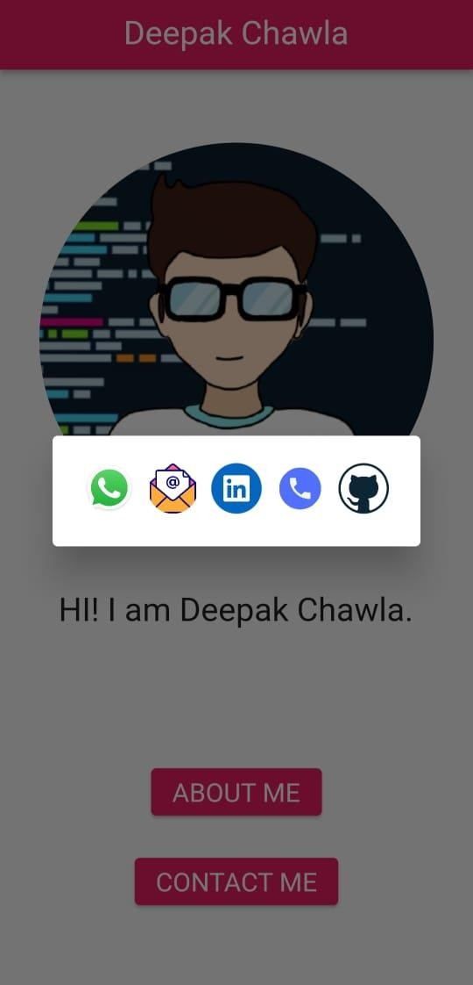
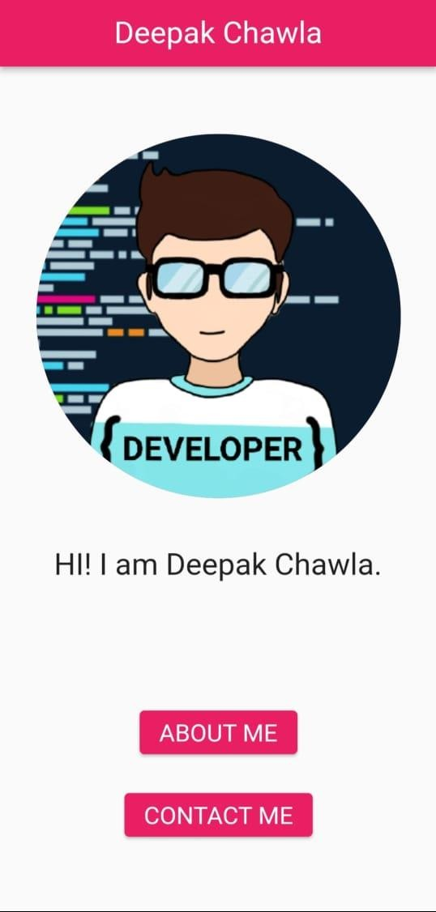

Slide 5
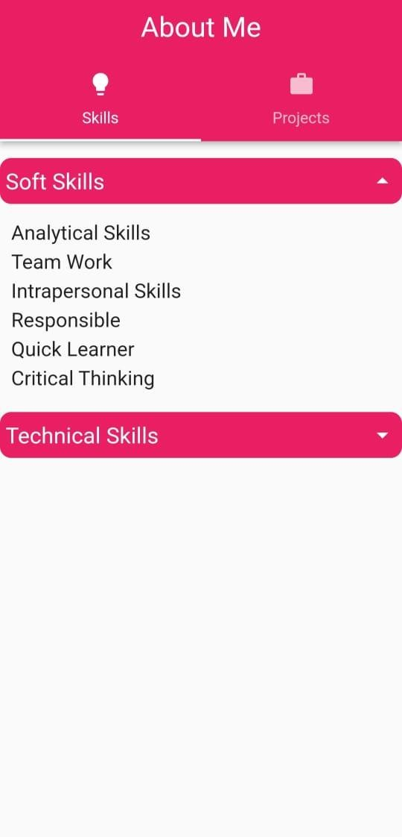
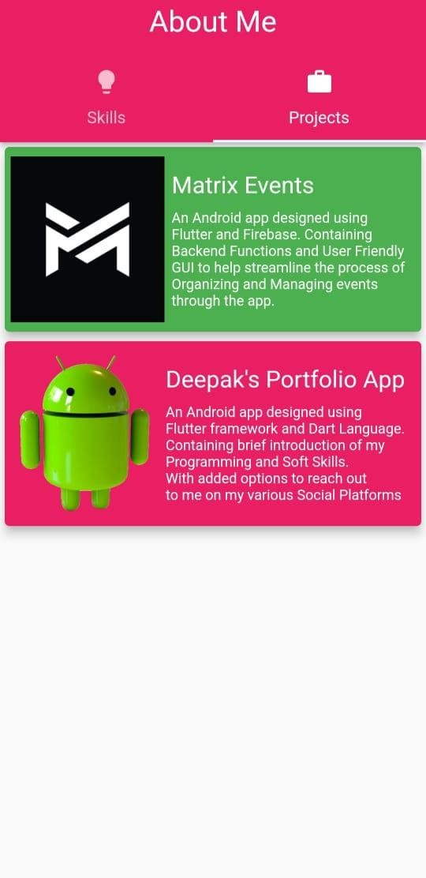

Slide 6
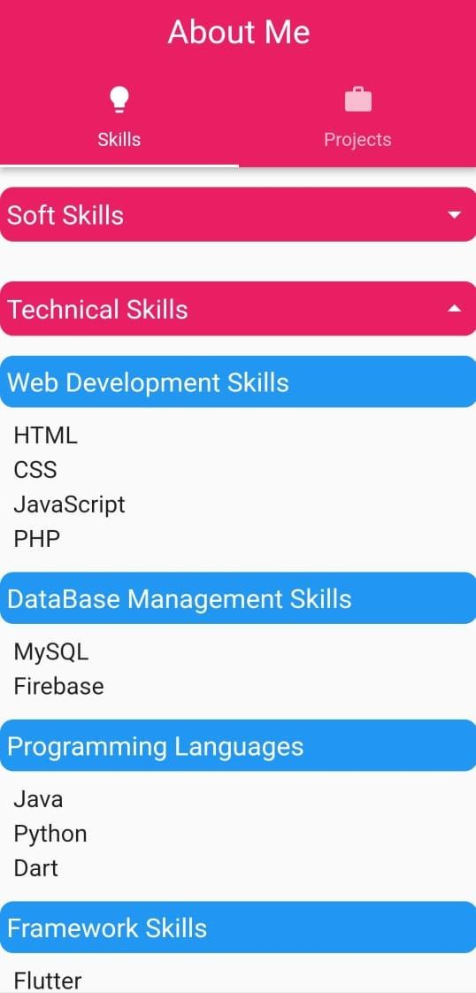
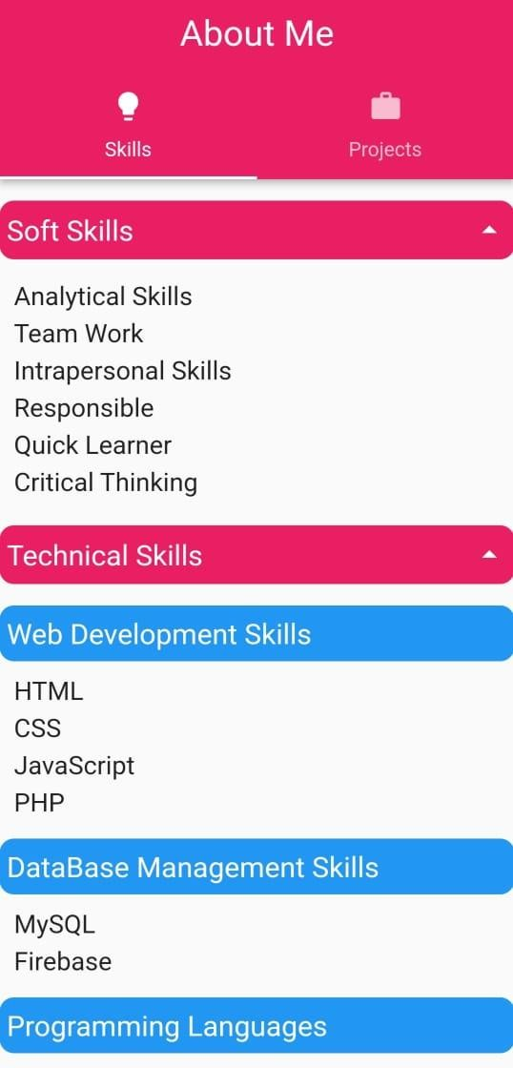

Slide 7
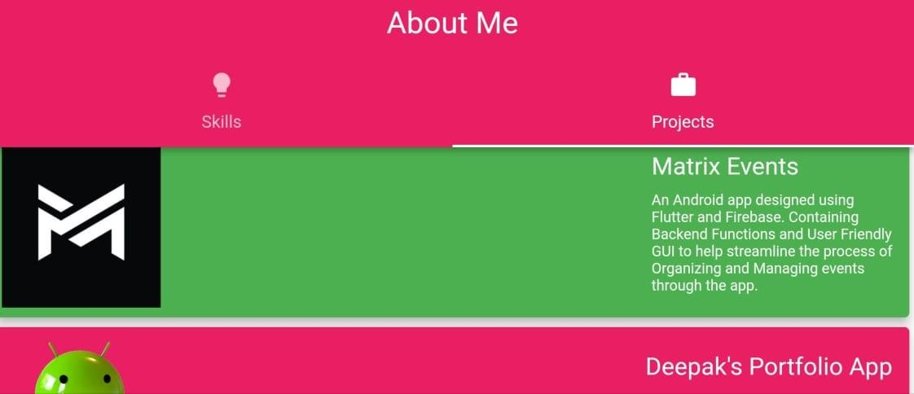
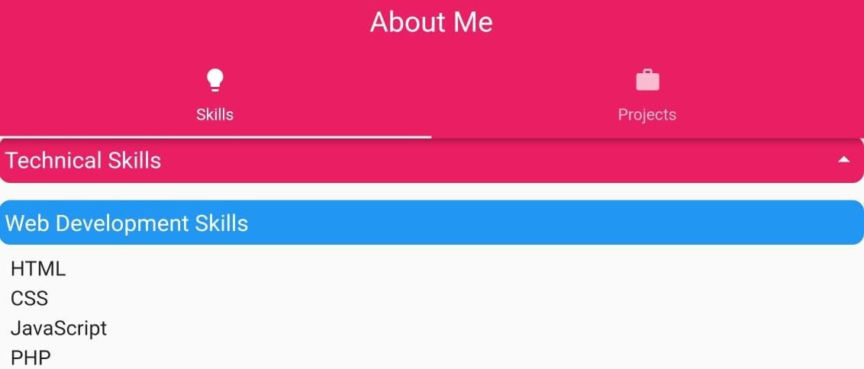

Slide 8
THANK YOU

